Slide 1
Smart Face Detection System
ELC Project Submission
Activity Title: Real-Time Object Detection and Drawing Effects
Topic: Face Detection
By: Kriti Sharma(2P11)
Roll Number: 102316019

Slide 2
Introduction & Objective
This project demonstrates a real-time face and smile detection system using Python and OpenCV. It automatically captures images when a user smiles, displays face count, allows manual image capture, and logs all smile events.

Slide 3
Tools & Technologies Used
Python 3.x
OpenCV
Haarcascade Pre-trained Models
Webcam
CSV for Logging Events
Clipchamp for Demo Recording

Slide 4
System Workflow
1. Access webcam feed.
2. Detect faces in real time.
3. Detect smiles inside detected faces.
4. Auto-capture and save image on smile.
5. Allow manual save via 's' key.
6. Log smile details with timestamp in CSV.

Slide 5
Real-Time Face Detection
Face detection is done using Haarcascade classifier.
Each face is marked with a blue rectangle.
The number of faces is displayed on screen.

Slide 6
Smile Detection & Auto-Capture
When a smile is detected, a green rectangle appears.
An image is automatically saved with a timestamped filename.
Smile data is logged in a CSV file.

Slide 7
Manual Save & Logging
- Press 's' to manually save a frame.
- All smile events are stored in 'smile_log.csv'.
- File names include timestamps for uniqueness.

Slide 8
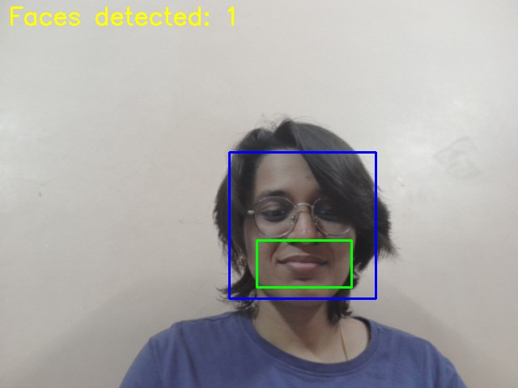
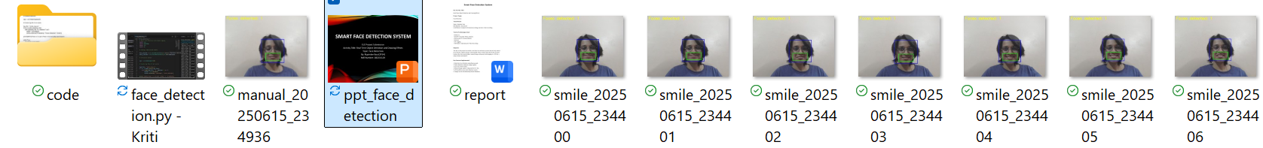
Output Screenshots
Face Detection with blue box
Smile Detection with green box
Saved image files in folder

Slide 9
Challenges & Learnings
Ensuring smile is not repeatedly detected
Handling real-time video frame updates
Maintaining proper file naming and log structure

Slide 10
Conclusion & Future Scope
This project is a practical application of computer vision for face and emotion detection.
Future additions could include:
- Mask detection
- Face recognition
- Hand gesture control integration

